Slide 1



Formation Big Data
Projet de Fin d’Etude
Olympic Games
Stagiaires
Houda OUALI ALAMI
Arthur TCHAMOKOUEN CHEPING
Grégoire RESVE
Romain ADANLETE
Responsables Formation
Mehdi TAZI
Razika BELHADDAD

Slide 2
PFE Big Data : Olympic Games Athens 1896 - Rio 2016
Summary
UC1-Datalake
UC2-Data Visualization
UC3-Operational & Real time
Demo

Slide 3
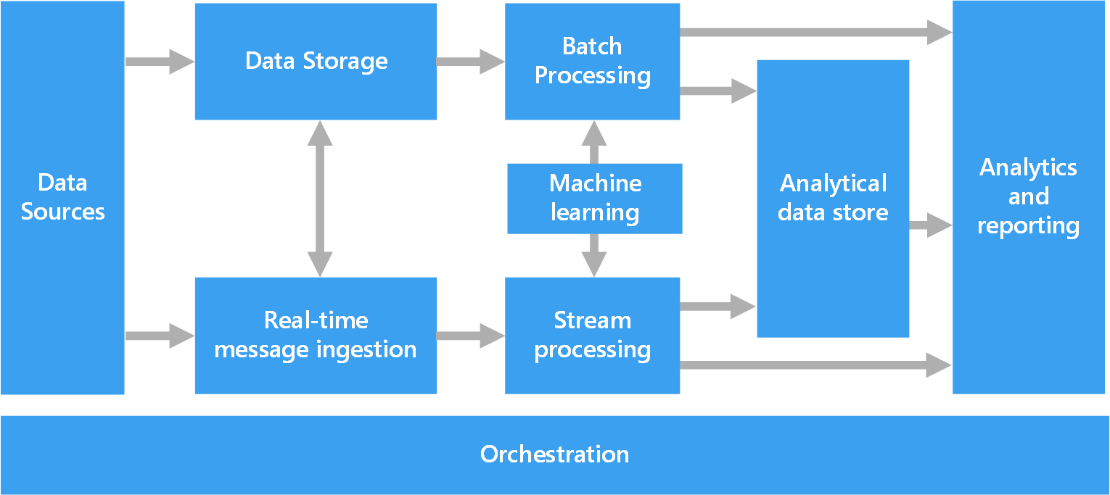
Architecture main components

Slide 4
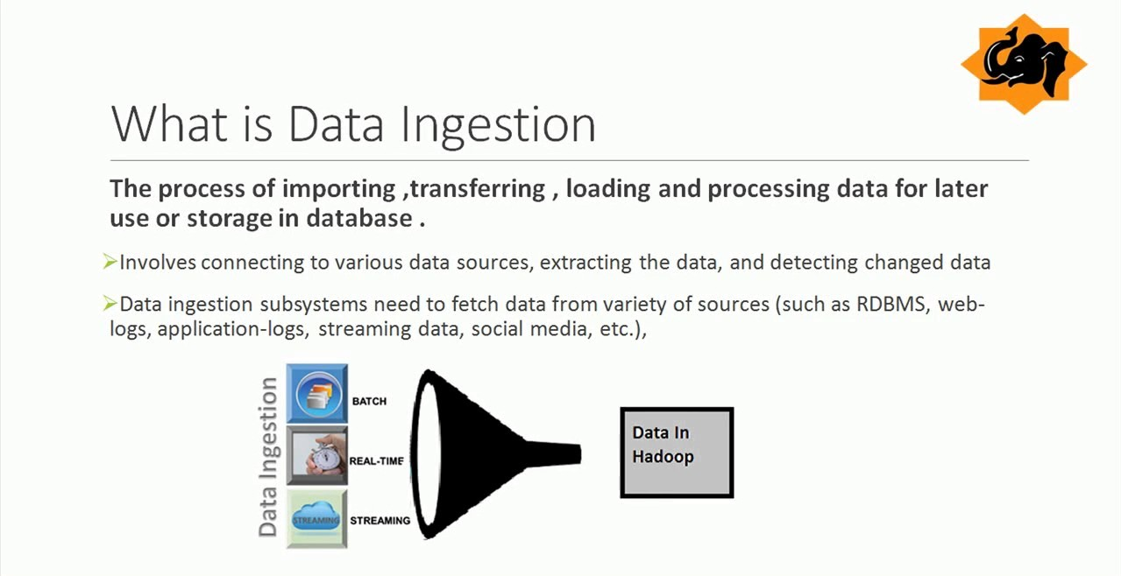
PFE Big Data : Olympic Games Athens 1896 - Rio 2016
UC1-Datalake
UC2
UC3
Demo
Notes:
le processus d’importation, de transfert, de chargement et de traitement des données à des fins d’utilisation ou de stockage ultérieurs dans les données. consiste à se connecter à diverses sources de données, à extraire les données et à détecter les journaux de données modifiés, les applications, les médias sociaux Strming Datsocial, etc

Slide 5



UC1 - Overview
SHELL
CSV
1896-Summer
…….
2008-Winter
Raw data ingestion/ Storage:
HDFS
OOZIE
Scala/Spark
External table:
JO-full-games
UC1 Tables
UC2 Tables
Textfile
Parquet

Slide 6






UC1 - Architecture - Technologies
Since a complex system is required to allow data exposure from our datalake many tools/technologies are used:
- HDFS Hadoop File Sytem for our datalake,
- Oozie for tasks scheduling,
- Hive to expose data,
- Scala/Spark to facilitate « complex » ingestion,
- Shell scripts to carry out some processsings triggered via Oozie
workflows.

Slide 7
UC1 – Datalake Architecture – Structures 1/2
1 - User (technical and ordinary users) Technical users creation: User Structure : core/Scala/src/main/scripts/initUserStructure.sh In order to manage security and access concerns /user/<username> Ex: /user/dev_jo /user/arthur_t | 2 - Application to run For applications management purpose /<env>/app/<projectname>/bin /<env>/app/<projectname>/oozie /<env>/app/<projectname>/oozie/coordinator/ /<env>/app/<projectname>/oozie/workflow/scripts

Slide 8
UC1 – Datalake Architecture – Structures 2/2
3 – Landing zone Place to send data to ingest (Tempo area) /<env>/ftr/<dataname>/data 4 – Data to store a - Raw data Place to store initial data without modification to ensure tracability /<env>/raw/<dataname>/data/version=current /<env>/raw/<dataname>/data/version=<YYYYMMDD> /<env>/raw/<dataname>/hive Ex: /dev/raw/JO/data/version=current /prd/raw/JO/data/version=20190709 | b - Lake data Place to store processed data for BI usage /<env>/lake/<dataname>/data /<env>/lake/<dataname>/hive Ex: /dev/lake/JO/data/ /prd/lake/JO/data/hive Applications structure : initApplicationStructure.sh

Slide 9
UC1 – Architecture –
Processing workflow 1/2
Oozie is used as scheduler.
All tasks are executed via Oozie workflows.
Workflow is call behind an Oozie coordinator/coordinator.xml
scripts/ingestion.sh: spark-submit

Slide 10
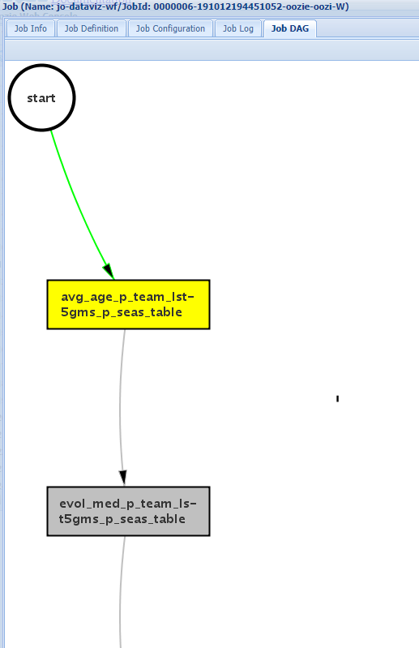
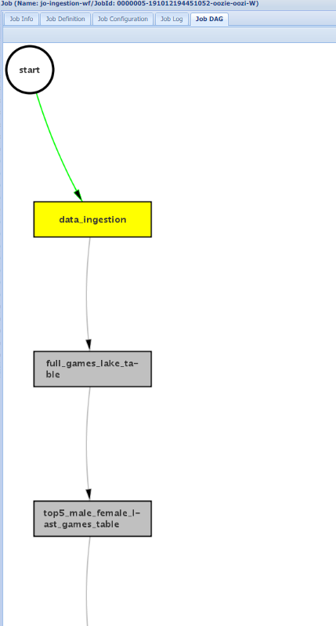
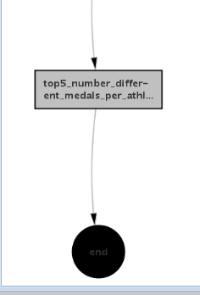
UC1 – Architecture –
Processing workflow 2/2

Slide 11


UC1 – Architecture - File types
Different filetypes are used to process all tasks :
- CSV filetype to store native data (data without any change)
- PARQUET filetype to help on analytic queries (faster processing as
compared to other file formats).

Slide 12
UC1 - Architecture - Tables
Two types of tables are created: external tables and managed tables
Hive is used to manage and query data already present in HDFS datalake:
External tables: they provide view on data already present. We can then easily request data.
Ex: dev_lake_jo.jo_full_games
Managed(internal) tables: used to store calculated data. In these tables, the data will be reset for each recalculation. So, each time new data will be received, the table will be truncated and populated anew.
Ex: - dev_lake_jo.jo_top5_male_female_last_games
- dev_lake_jo.jo_top5_athletes_per_country

Slide 13

UC1 – Scripts - Ingestion - Raw
As explained in previous slide, Scala/Hadoop FileSystem(Spark) is used to ingest data.
The files we have to ingest in the datalake are stored into a landing zone on our cluster.
The filename pattern is <year>-<season>.csv
Each time the workflow will run and a file is found in the folder, it will be ingested in the raw space set in datalake.
If a same « year-season » already exists into raw, it will be archived into specific timeline (versionning)folder before the ingestion occurs.
Path examples :
- Development environment HDFS: /dev/raw/JO/data/version=current/2016-summer/xxxxx.csv
- Archive environment : /data/raw/JO/data/version=20190709/2016-summer/xxxxx.csv
Notes:
Les fichiers traités par le processus d’ingestion sont mis dans le répertoire « done » afin de garder une traçabilité des fichiers traités et d’éviter de réingérer le fichier s’il était resté dans le répertoire.

Slide 14

UC1 – Scripts - Ingestion - Lake
Same here, Scala/Spark is used to transform csv files into parquet files type for analytical purpose.
Each time the workflow runs, the parquet files will be replaced.
A path example : /dev/lake/JO/data/Games=2016-Summer/xxxxx.parquet
Notes:
Transformed files are stored into a specific folder on the cluster. This folder is « lake ».
The parquet files will be regenerated each time the workflow will run

Slide 15

UC1 – Scripts - Metric tables
Assuming data is available in the lake in parquet format:
First : create a Hive external table for the whole parket file storage
Second : create managed tables based on previous external table.
This will enable to generate new data, that is « Metric data ».
8 managed tables, one for each of the 8 metrics requested in UC1.
6 managed tables, one for each of the 6 BI metrics used in UC2.
Scripts : Appendix 1.3.1 - External table
Ex : last_jo_avg_age:
Notes:
les données sont disponibles dans le lac en format parquet : Premièrement : créer une table externe Hive pour l’ensemble du stockage de fichiers parket Deuxièmement : créer des tableaux gérés en fonction du tableau externe précédent. Cela permettra de générer de nouvelles données, c’est-à-dire des « données métriques ». 8 tableaux gérés, un pour chacune des 8 mesures demandées dans UC1.

Slide 16

PFE Big Data : Olympic Games Athens 1896 - Rio 2016
UC1
UC2-Data Visualization
UC3
Demo

Slide 17
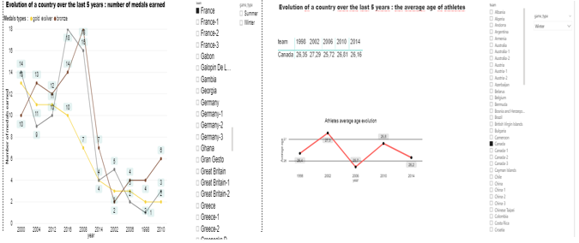
UC2 - Overview
ODBC Hive connector
Power BI
last_jo_top5_team
last_jo_top5_f
……
Tables UC2
Notes:
A partir des données du datalake on avait besoin de generer des rapports, pour cela nous avons créé des tables sur hive (hue), en utilisant le connecteur Hadoop ODBC Hive de microsft on a exporté les données sur power BI via ce connecteur,

Slide 18




UC2 – Dataviz tool choice 1/2
.We had several choice of dataviz tools.
To make our choice we used a simple matrix with 5 points of interest.
. Cost
. Function
. Facility to use
. Datalake connection
. Manage huge volume of data
Notes:
Nous avions plusieurs choix d’outils dataviz.
Pour faire notre choix, nous avons utilisé une matrice simple avec 5
points d’intérêt.
. Coût
. Fonction
. installation à utiliser; . connexion Datalake
. Gérer une énorme quantité de données

Slide 19
UC2 – Dataviz tool choice 2/2
After compilation of notes given for each of these tools we choose Power BI which is :
Simple to use. Lot of training available on the web.
Free license (more than 2 weeks compared to Tableau)
Lot of functions and all functions we need to accomplish our tasks
Easy to connect to Hadoop datalake.
Can load, process and build chart and report from huge data.
Notes:
Après la compilation des notes données pour chacun de ces outils, nous choisissons Power BI qui est : Simple à utiliser. Beaucoup de formation disponible sur le web. Licence gratuite (plus de 2 semaines par rapport à Tableau) Beaucoup de fonctions et toutes les fonctions dont nous avons besoin pour accomplir nos tâches Facile à connecter à Hadoop datalake. Peut charger, traiter et construire graphique et rapport à partir de données énormes.

Slide 20
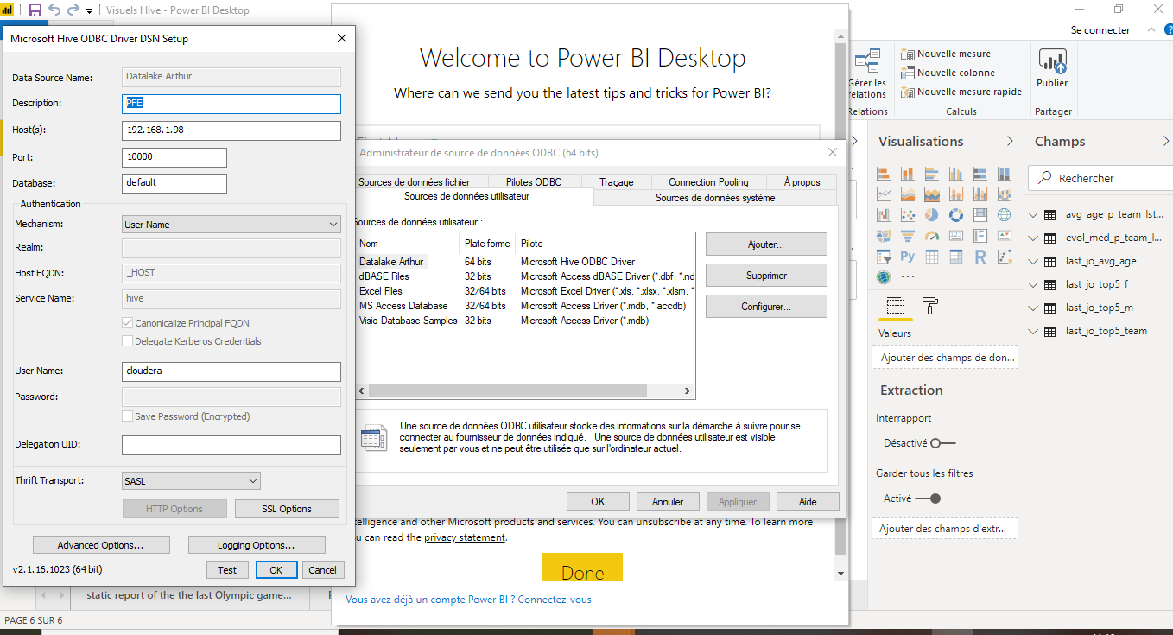

UC2 – Connectivity
In order to load the data on which reports and charts are based,
we have connected the reporting tool Power BI on Hive platform using an ODBC connector .
Notes:
Afin de charger les données sur lesquelles les rapports et les graphiques sont basés, nous avons connecté l’outil de rapport Power BI sur la plate-forme Hive à l’aide d’un connecteur ODBC .
A partir des données du datalake on avait besoin de generer des rapports, pour cela nous avons créé des tables sur hive (hue), en utilisant le connecteur Hadoop ODBC Hive de microsft on a exporté les données sur power BI via ce connecteur,

Slide 21

UC2 – Metric tables
Assuming data is available in the lake in parquet format, we create managed tables based on previous external table :
6 managed tables, one for each of the 6 BI metrics used in UC2.
Scripts - Ex : managed tables

Slide 22
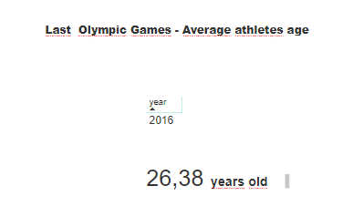
UC2 - Static report of the last OG Average athletes age

Slide 23
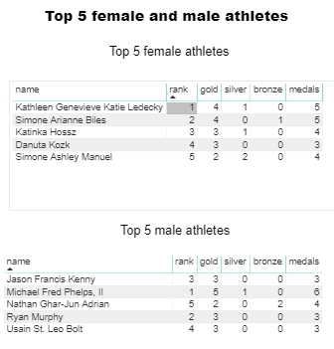
UC2 - Static report of the last OG Top 5 female and male athletes

Slide 24
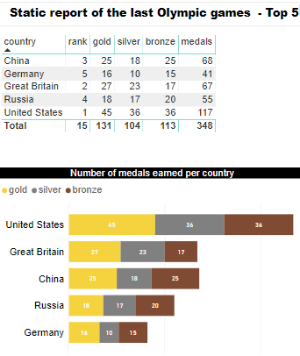
UC2 - Static report of the last Olympic games Top 5 best countries

Slide 25
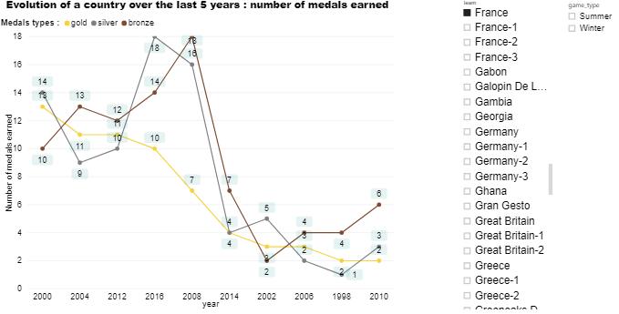
UC2 - Dynamic charts Evolutions over last 5 years

Slide 26
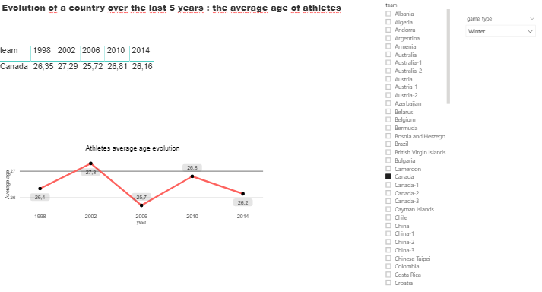
UC2 - Dynamic charts Evolutions over last 5 years

Slide 27
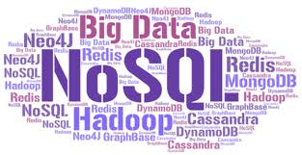
PFE Big Data : Olympic Games Athens 1896 - Rio 2016
UC1
UC2
UC3-Operational
& Real time
Demo

Slide 28
UC3- Overview
HDFS
Spark/Scala
CSV
Lake
JSON File
OOZIE
Summer-2016
Mongodb

Slide 29
UC3 – Database choice 1/2
Because lot of random R/W operations are done and because the volume is big but not very huge (less than Pbytes), we have chosen an Operational Database :
Both Relational database or NoSQL database are convenient.
To determinate what kind of databases we need, we have used the CAP principles.
As the tables are designed by query, NoSQL database are definitely more suitable.
Because Availability is not really required we can pick a database for which Partition Tolerance and Consistency requirements are fullfilled. In this case the databases range is somewhat wide : Cassandra, MongoDB, Hbase, CosmosDB etc.
The choice of the database was based on an selection matrix.
Notes:
Les modifications étant petites et nombreuses, plus la volumétrie relativement peu élevée, HDFS n’est pas adaptée. Perf.

Slide 30



UC3 – Database choice 2/2
To determinate which database to implement, we have used a multi criteria matrix.
According to the matrix in our context, the best choice is MongoDB Database.
 | Weight | MongoDB | Cassandra | Hbase
Cost | 1,5 | 4 | 4 | 5
Avaibility | 0,5 | 3 | 4 | 3,5
Consistency | 1 | 4 | 3 | 4
Language | 2 | 4 | 2,5 | 1
Total | 5 | 3,9 | 3,2 | 3,05

Slide 31

UC3 – Technologies
To help operational team to request our MongoDB database, we propose them different tools to manage (administration) collections and documents :
Terminal
Robo 3T
Studio 3T
Robo 3T is a free version. It’s easy to install and manipulate.
Notes:
A supprimer????

Slide 32
UC3 – Document Structures
To execute real R/W operations, our operational database should have documents which expose all fields for which modifications can be done.
As no restriction has been given, we consider the possibility to modify all fields (exept athlet ID).
The modifications occur only for the last game.
The Collection which stores our documents is named is call LastGames and is a part of database named JO

Slide 33
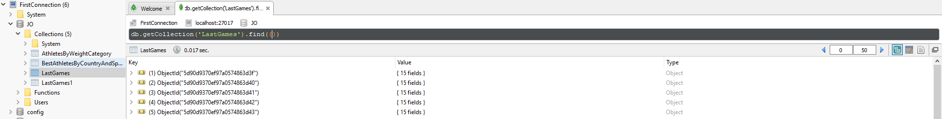
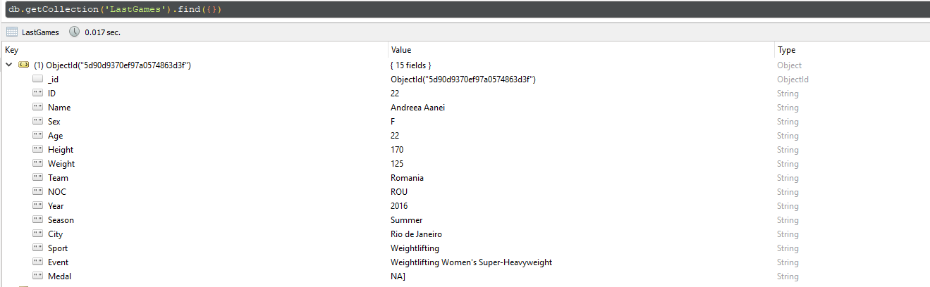
UC3 – JO.LastGames Collection

Slide 34
UC3 – MongoDB - Initial load scripts
We use Scala/Spark to copy data from datalake to our MongoDB collection.
Scripts consist in initiating a SparkSession with some settings relating to mongodb
.config("spark.mongodb.input.uri", "mongodb://localhost:27017/JO.LastGames")
.config("spark.mongodb.input.readPreference.name", "secondaryPreferred")
.config("spark.mongodb.output.uri", "mongodb://localhost:27017/JO.LastGames")
A dataframe is created using the SparkSession based on source data. Then we transform it in RDD.
Then the rdd is written into mongodb database using a specific class from :
import com.mongodb.spark.MongoSpark

Slide 35
UC3 – DesignByQuery Structure 1/2
Optimized document designed to return the list of the best athletes per country and per sport.
Used for research purpose and not for modification.
BestAthletesByCountryAndSport
ID | Integer
Name | String
City | List
Sport | String
Rank | Integer

Slide 36
UC3 – DesignByQuery Structure 2/2
Optimized document designed to return the list of athletes per range of weight (40-, 40-60, 60-80, 80-100,100+)
Used for research purpose and not for modification.
AthletesByWeightCategory
ID | Integer
Name | String
WeightRange | String

Slide 37

PFE Big Data : Olympic Games Athens 1896 - Rio 2016
UC1
UC2
UC3
Demo

Slide 38
PFE Big Data : Olympic Games Athens 1896 - Rio 2016
End

